Slide 1
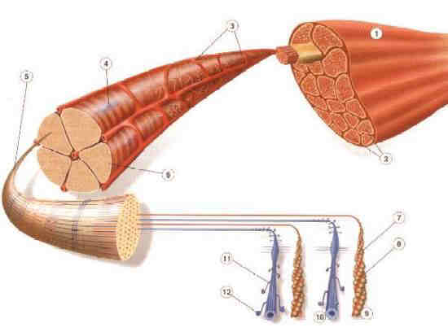
Neuromuscular disorders - myopathies
Abbasi V. MD neurologist

Slide 2
Neuromuscular disorders
Radiculopathies
Plexopathies
Mononeuropathies
Polyneuropathies
Motoneuron diseases
Myopathies
Disorders of the neuromuscular junction

Slide 3
Clinical presentation by affected region
General consideration ( many people use numb = weak ) . → weak = loss of muscle strength objective or by hx
R/o malingering or orthopedic conditions
The patient whose weakness is caused by depression
or malingering has vague symptoms and avoids answering leading questions, and the stereotypical symptoms of weakness are seldom volunteered. Instead, such patients make statements such as "I have no strength to do the housework
The first key in evaluating weakness is to discern which muscle groups are affected.

Slide 4
Symptoms of muscle disease
Muscle fatigue, exercise intolerance in general
Proximal and symmetric weakness
Waddling gait; difficulty of rising from sitting, climbing stairs; Gower’s sign
Hyperextension of the knee
Increased lordosis of the lumbar spine, scoliosis
Contractures, tight Achilles tendons
Myopathic face
Muscle atrophy; pseudohypertrophy of calf
Myotonia
Tendon reflexes are normal or decreased

Slide 5
Diagnosis of muscle diseases
Creatinine kinase levels increased in many myopathies (sign of muscle fiber necrosis)
ENG / EMG: differentiation between neurogenic and myogenic weakness
Muscle biopsy: signs of muscle fiber abnormality, inflammation, immunostaining of muscle constituents
Genetic testing

Slide 6
Serum Creatine Kinase
neurogenic disease, in which normal or mild to moderate elevations of CK may be seen,
and myopathies, in which the CK concentration often is markedly increased.
Black men only: 520 U/liter
Black women, non-black men: 345 U/liter
Non-black women: 145 U/liter
levels in 2.5% of the normal population will be above that.
the serum CK concentration can be useful in determining the course of an illness : In treating inflammatory myopathies and in myoglobinuria (The concentration then declines steadily by approximately 50% every 2 days.
exercise may cause a marked elevation in CK, which usually peaks 12 to 18 hours after the activity but may occur days later

Slide 7
Muscle Biopsy
All biopsy procedures carry a risk of sampling error. Not all muscles are equally involved in any given disease, and it is important to select a muscle that is likely to give the most useful information.
The gastrocnemius muscle, often chosen for muscle biopsy, is not ideal because:
it demonstrates a predominance of type I fibers in the normal person
and often shows denervation changes caused by minor lumbosacral radiculopathy.
In addition, it has more than its fair share of random pathological changes, such as fiber necrosis and small inflammatory infiltrates, even when no clinical suspicion of a muscle disease exists.
For this reason, it is preferable to select either the quadriceps femoris or the biceps brachii if either of these muscles is weak.

Slide 8
biopsy
A biopsy should never be performed on a muscle that is the site of a recent EMG or intramuscular injection, because these procedures produce focal muscle damage. If such a muscle has to be biopsied, at least 2 to 3 months should elapse after the procedure before the biopsy is performed.
In the patient with a relatively acute (duration of weeks) disease, it is wise to select a muscle that is obviously clinically weak.
In patients with long-standing disease, it may be better to select a muscle that is almost normal to avoid an "end-stage“ muscle.

Slide 9
Biopsy
Sometimes an apparently normal muscle is biopsied. For example, in a patient who is suspected of having motor neuron disease and who has wasting and weakness of the arms with EMG changes of denervation in the arms but no apparent denervation of the legs, biopsy of the biceps muscle would show the expected denervation and would add no useful information. Biopsy evidence of denervation in a quadriceps muscle, however, would be consistent with widespread involvement, supporting the diagnosis of motor neuron disease. Normal findings on biopsy of the quadriceps muscle make the diagnosis of ALS less likely, because even strong muscles in patients with ALS usually show some denervation. ALS is not an indication for biopsy unless the diagnosis is in question.

Slide 10
genetic testing
This is a distinct advantage to the patient if a blood test can substitute for a muscle biopsy. The use of genetic testing for diagnosis in a specific patient implies that the genetic cause of a specific disease is established and that intragenic probes are available that allow the determination of whether the gene in question is abnormal.
Examples of such abnormalities are:
deletions in the dystrophin gene, seen in many cases of Duchenne muscular dystrophy,
and the expansion of the triplet repeat in the myotonic dystrophy gene.
Linkage studies are useful

Slide 11
Is it really myopathy ?

Slide 12
Types of muscle diseases
Hereditary muscle diseases
Muscle dystrophies
Muscle channelopathies
Mitochondrial myopathies
Metabolic myopathies
Acquired muscle diseases
Inflammatory myopathies
Endocrine and toxic myopathies
Infectious muscle diseases

Slide 13
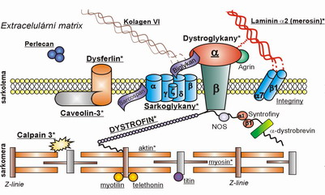
Muscle dystrophies
Hereditary myopathies, characterized by progressive weakness and muscle atrophy
Genetic defect of proteins constituting the sarcolemma-associated cytoskeleton system

Slide 14
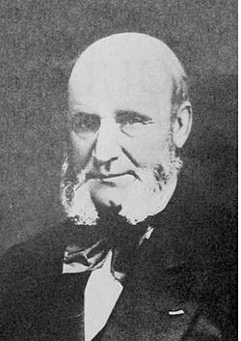
Duchenne muscular dystrophy
Dystrophinopathy
First described in 1881- dystrophin gene discovered in the early 1980's
Cause: deficiency of dystrophin, resulting in progressive loss of muscle fibers
Becker’s type: reduced amount of dystrophin; more benign course
X-chromosome linked
1 in 3500 live births, occurs in boys, girls are carriers

Slide 15
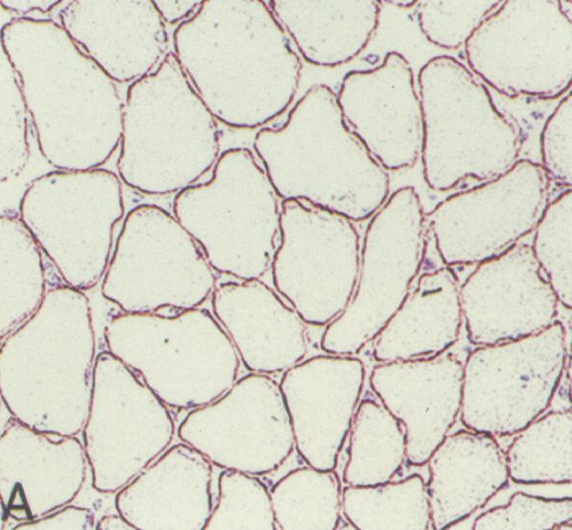
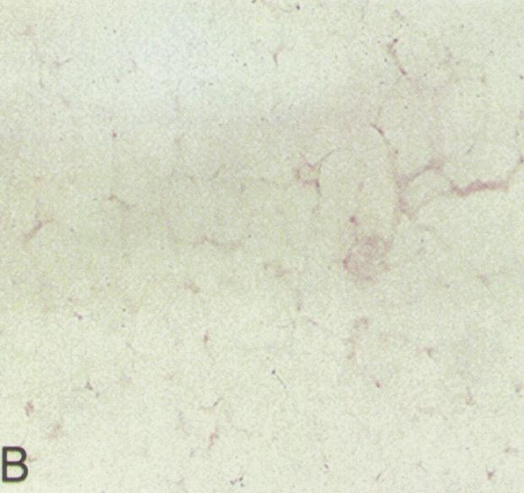
Duchenne muscular dystrophy
Normal Duchenne dystrophy
Diagnosis:
Lack of immunostaining of dystrophin in muscle biopsy specimen
Demonstration of deletion in the dystrophin gene

Slide 16
Duchenne muscular dystrophy
Onset at 3-5 years
Initial symptoms: difficulty getting up from deep position and climbing steps, waddling gait
Weakness most pronounced in limb-girdle muscles, trunk erectors; craniobulbar muscles are spared
Skeletal deformities
Cardiomyopathy
Inability to walk by 9-11 years
Death occurs usually in the 3rd decade,
from respiratory insufficiency

Slide 17
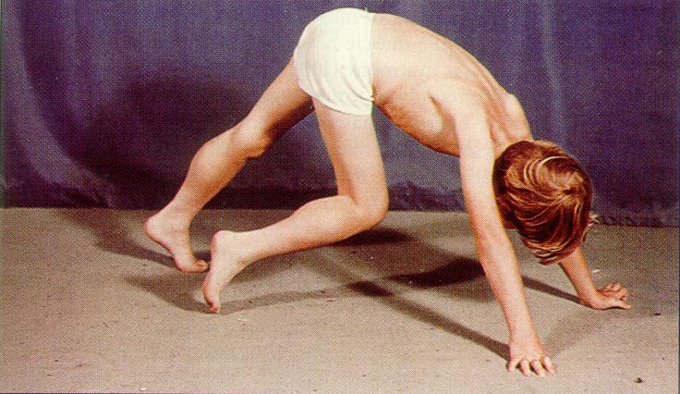
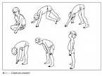
Duchenne muscular dystrophy
Gower’s sign

Slide 18
Gowers’ Maneuver

Slide 19
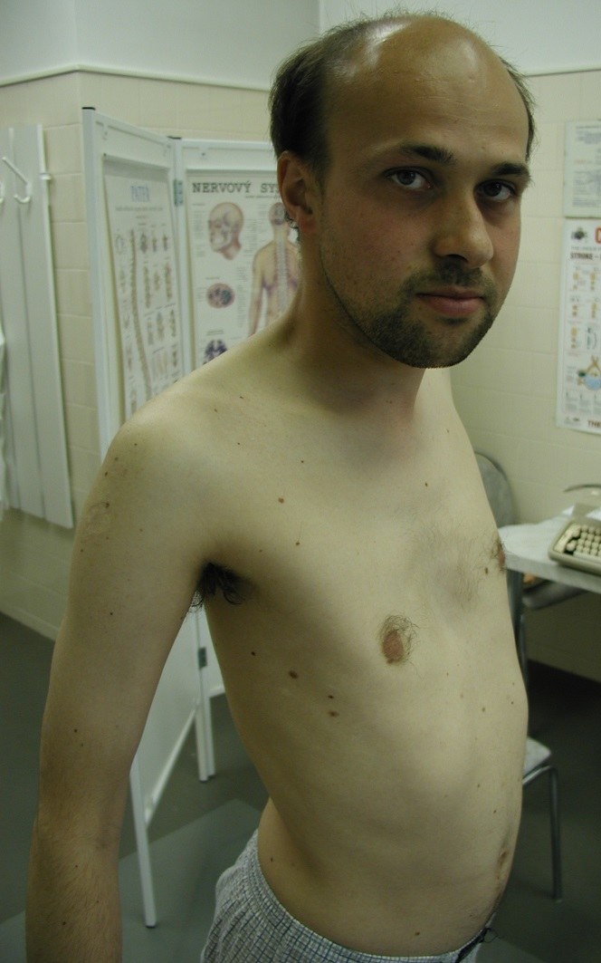
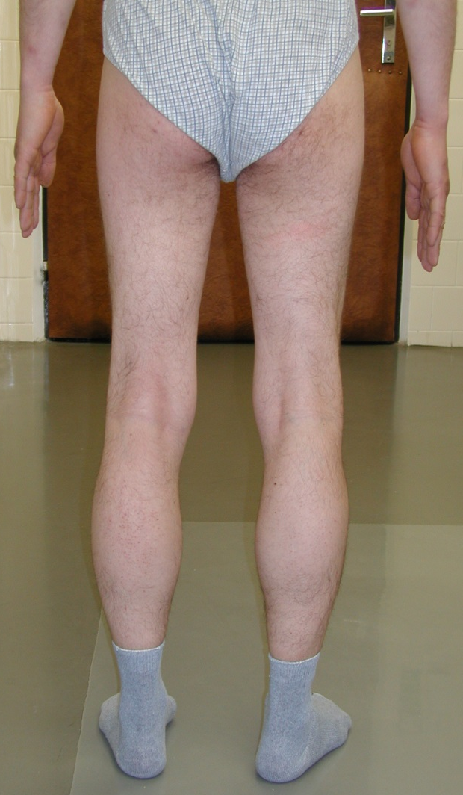
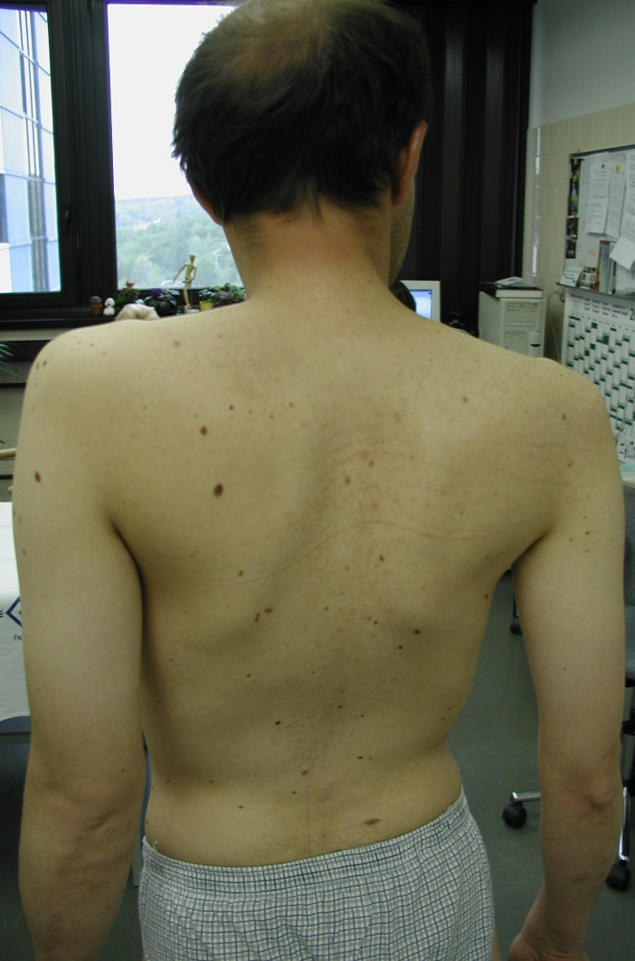
Becker´s dystrophinopathy

Slide 20
Myotonic dystrophy 1
Prevalence: 1 in 8000
Cause: CTG repeat expansion in a gene on chr. 19
Autosomal dominant inheritance, with anticipation
Multisystemic disease:
Myotonia: hyperexcitability of muscle membrane → inability of quick muscle relaxation
Progressive muscular weakness and wasting, most prominent in cranial and distal muscles
Cataracts, frontal balding, testicular atrophy
Cardiac abnormalities, mental retardation

Slide 21
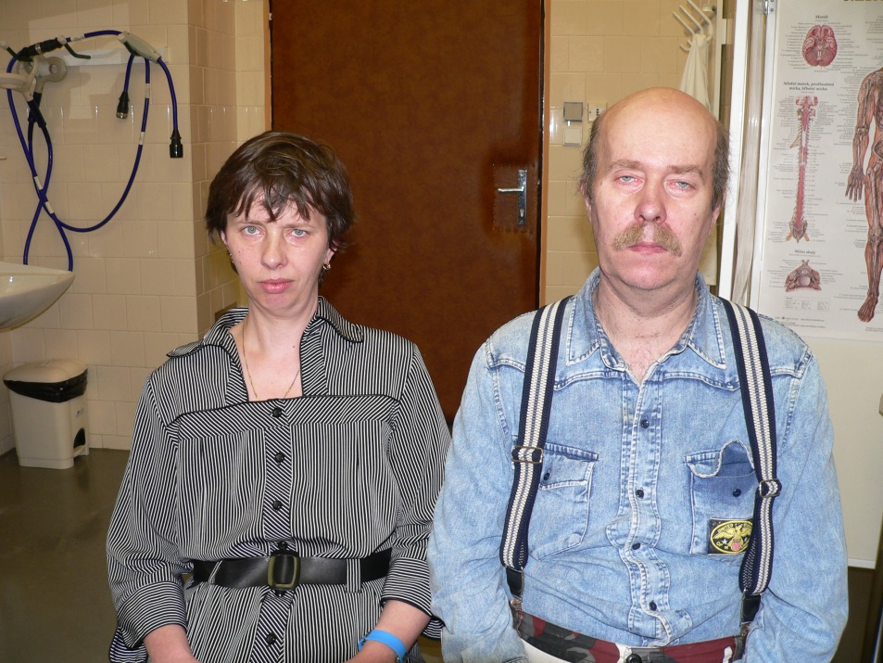
Myotonic dystrophy 1

Slide 22
Limb-girdle dystrophies
Causes:
Sarcoglycanopathies
Calpain deficiency
Caveolin deficiency
Dysferlin deficiency etc.
Sarcoglycanopathies comprise about 10% of autosomal recessive limb-girdle dystrophies
α, β, γ, δ sarcoglycans

Slide 23
Facioscapulohumeral dystrophy
Prevalence: 1 in 20,000
Autosomal dominant
Age of onset: infancy to middle age
Progressive muscular weakness and atrophy involving the face, scapular, proximal arm and peroneal muscles → myopathic face, winging of the scapula, inability to raise the arms, foot drop
Life span is not significantly affected

Slide 24
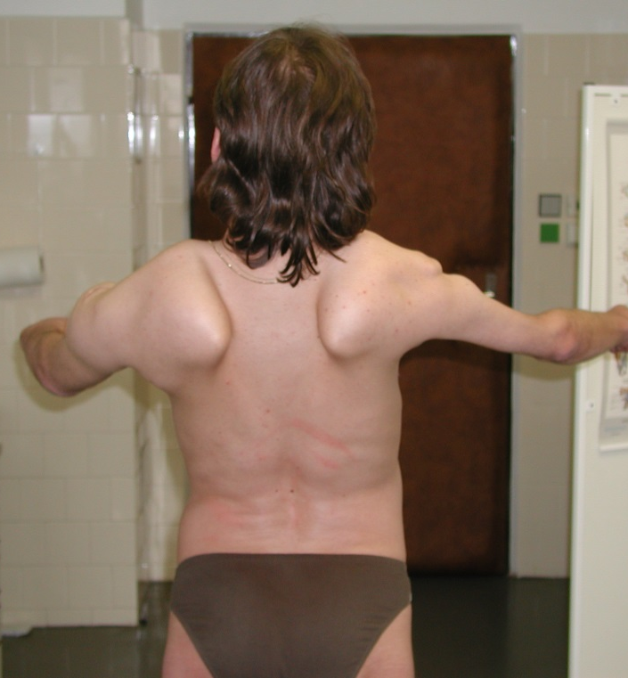
FSHD

Slide 25
Muscle channelopathies

Slide 26
Myotonia congenita
Mutation in the muscle Cl⁻ gene
autosomal dominant form: Thomsen autosomal recessive form: Becker
Symptoms:
Myotonia (hyperexcitability of the muscle membrane): muscle stiffness and abnormal muscle relaxation, warm-up phenomenon
Hypertrophied muscles
Therapy: phenytoin, mexiletin

Slide 27
Inflammatory muscle diseases
Dermatomyositis
Polymyositis
Inclusion body myositis
Other systemic autoimmun diseases (SLE, Sjögren sy. etc.)

Slide 28
Dermatomyositis
Humorally mediated autoimmune disease affecting the muscles and skin (microangiopathy)
Symptoms progress over weeks, months
Rash on the face and neck
Periorbital oedema
Pain and weakness of proximal limb muscles, neck flexors
Dysphagia
Cardiac abnormalities, interstitial lung disease
Often paraneoplastic

Slide 29
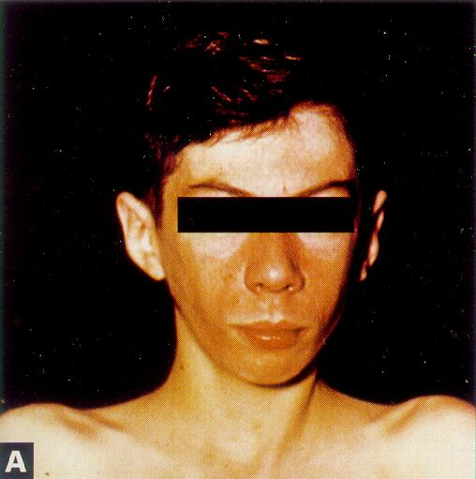
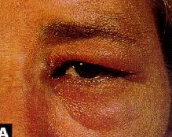
Dermatomyositis

Slide 30
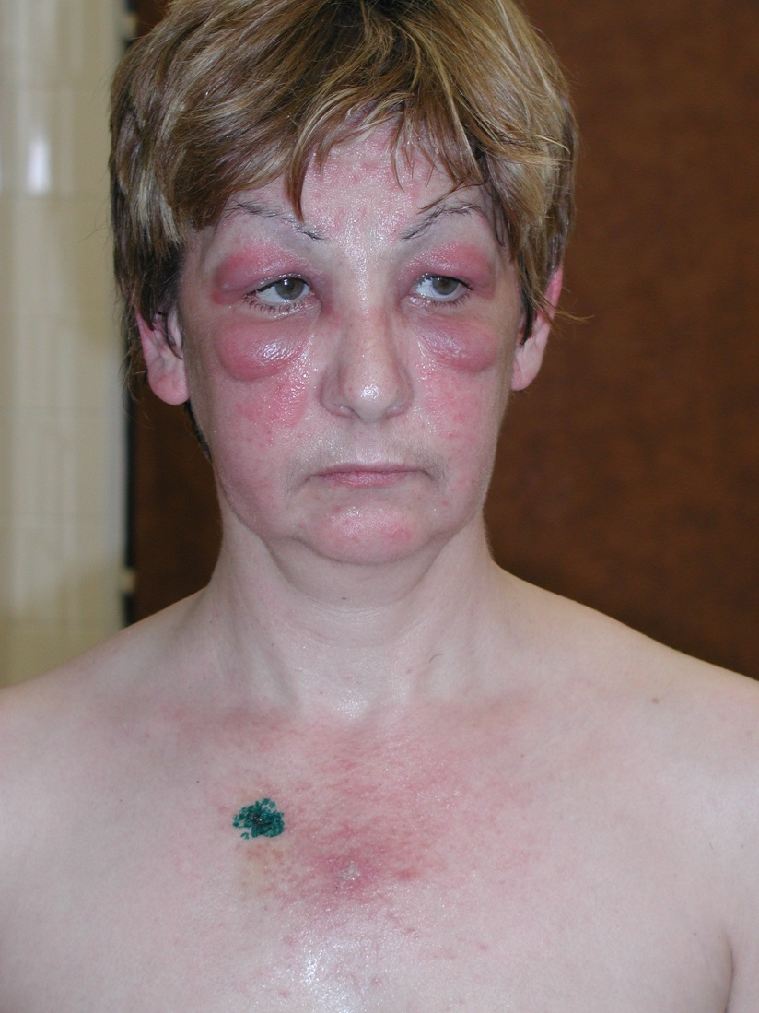
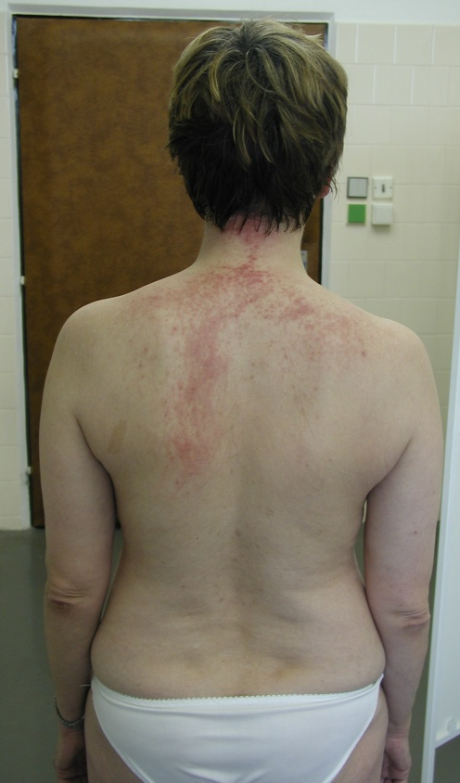
Dermatomyositis

Slide 31
Polymyositis
Cell-mediated immune response against muscle fibers
Symptoms are similar to DM, no skin involvement
Less often paraneoplastic than DM

Slide 32
Diagnosis / therapy of DM, PM
Blood CK levels are elevated
EMG: myogenic findings
Muscle biopsy: inflammation
DM: perivascular infiltration, mainly in the perimysium
PM: endomysial inflammation
Therapy: immunosuppression, long-term treatment with corticosteroids (1 mg/kg/day)

Slide 33
Endocrine and toxic myopathies
Toxic myopathies:
Drugs aimed at reducing blood lipid levels: statins, clofibrate
Corticosteroids – steroid myopathy
Alcohol in a couple of days
Heroin

Slide 34
Endocrine and toxic myopathies
Endocrine myopathies
Thyreotoxic myopathy
Hypothyreodism
Hyperparathyreodism
Adrenal insufficiency
Hypokalemia

Slide 35
Disorders of the Neuromuscular Junction
Myasthenia gravis

Slide 36
Definition
An autoimmune disease due to an antibody mediated attack directed against nicotinic AchR at neuromuscular junction
10% have thymoma
70% have thymic hyperplasia

Slide 37
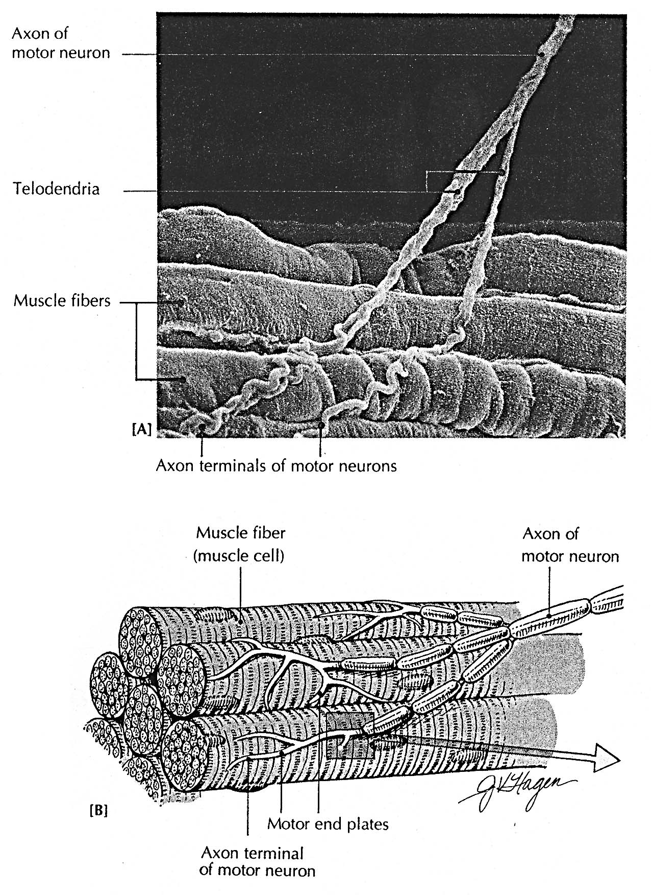

Slide 38
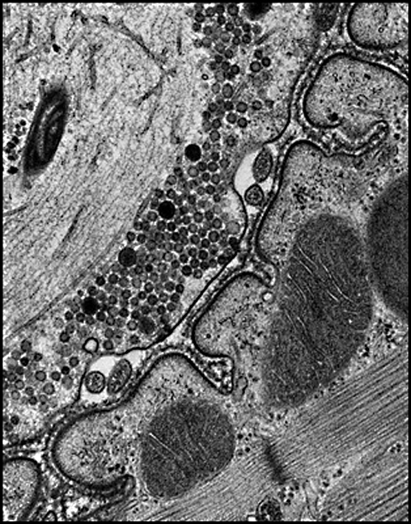
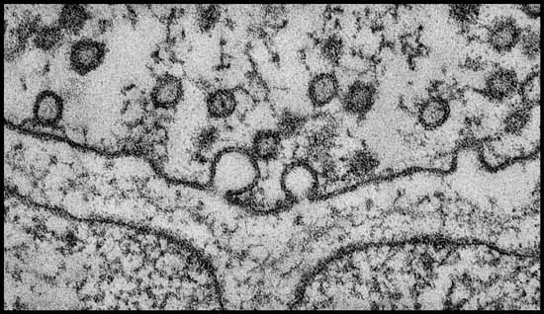
Synaptic antigens
nerve
VGCC
muscle
MuSK
AChR

Slide 39
Epidemiology of Myasthenia Gravis

Slide 40
Epidemiology
Incidence 1 : 20 000 in USA
Women slightly higher incidence 3 : 2
Majority of the MG are young women in the third decade and middle aged men in 5th and 6th decade
Children account for 11% of all patients with MG

Slide 41
Clinical Presentation of Myasthenia Gravis
fatigue, it is not usually the major or presenting complaint.
Ptosis or diplopia
Difficulty chewing, swallowing, or talking
limb weakness

Slide 42
Myasthenic weakness typically fluctuate s during the day, usuall y being least in the morning and worse as the day progresses,

Slide 43
The course of disease is variable but usually progre ssive.
In our experience, weakness remains restricted to the ocular muscles in approximately 10% of case s (ocular myasthenia ), although others have reported lack of spread in more than 40%.
In the rest, weakne ss progresses during the first 2 years and ultimately involves oropharyngeal and limb muscles (generalized myasth enia) . Maximum weakness occurs during the first year in two thirds of patients .

Slide 44
Symptoms typically fluctuate over a relatively short period and then become more severe (active stage) .
Left untreated, an inactive stage follows the active stage, in which fluctuations in strength still occur but are attributable to fatigue, intercurrent illness, or other identifiable factors.
After 15 to 20 years, untreated weakness becomes fixed, and the most severely involved muscles are frequently atrophic (burnt-alit stage).

Slide 45
Factors that worsen myasthenic symptoms

Slide 46
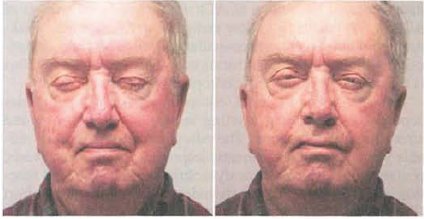
Physical Findings in Myasthenia Gravis
Ocular Muscles

Slide 47
TABLE 82-1 Ocular Findings in Myasthenia Gravis
Weakness usually involves one or more ocular muscles without overt pupillary abnormality.
Weakness is typically variable, fluctuat ing, and fatigable .
Ptosis that shifts from one eye to the other is virtually pathognomonic of MG.
Pseudo-internuclear ophthalmoplegia-limited adduction , with nystagmoid jerks in abducting eye.
In asymmetric ptosis , covering the eye that has lid ptosis may relieve contraction of the opposite frontalis.
Passively lifting a ptotic lid may cause the opposite lid to fall
Edrophonium may improve only some of several weak ocular muscles; others may actually become weaker.
Cold applied to the eye may improve lid ptosis.

Slide 50
Ph/ex
Oropharyngeal Muscles
Limb Muscles: Neck flexors are usually weaker than neck extensors, and the deltoids, triceps, and extensors of the wrist and fingers and ankle dorsi flexors are frequently weaker than other limb muscles .

Slide 51
Inheritance of Myasthenia Gravis
Immunopathology of Myasthenia Gravis
The Thymus in Myasthenia Gravis

Slide 52
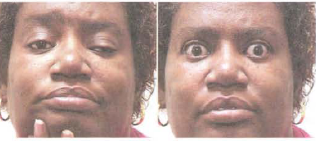
Diagnostic Procedures in Myasthenia Gravis
Edrophonium Chloride Test

Slide 55
Diagnostic Procedures in Myasthenia Gravis
Auto-Antibodies in Myasthenia Gravis
Antistriational Muscle Antibodies
Acetylcholine Receptor Antibodies
Anti-MuSK Antibodies
Other Autoantibodies
Electrodiagnostic Testing in Myasthenia Gravis
Ocular Cooling
Other Diagnostic Procedures in Myasthenia Gravis: chest imaging study, tuberculosis skin test

Slide 56
Low frequency stimulation - decrement

Slide 57
Treatment of Myasthenia Gravis
Cholinesterase Inhibitors
Thymectomy
Corticosteroids
Immunosuppressant Drugs
Plasma Exchange
Intravenous Immunoglobulin
Association of Myasthenia Gravis with Other Diseases

Slide 58
Treatment Plan for Myasthenia Gravis
Ocular Myasthenia
Generalized Myasthenia, Onset before Age 60
Generalized Myasthenia, Onset after Age 60
Thymoma
Myasthenic or Cholinergic Crisis
Pregnancy

Slide 59
Myasthenic crisis
Respiratory insuficiency – paralysis of respiratory muscles
Assisted ventilation required
Affect 15-20% myasthenic patients
Females : males = 2 : 1
Average age : 55 years

Slide 60
Lambert-Eaton myasthenic syndrome
In the Lambert-Eaton myasthenic syndrome, fluctuating weakness also may occur, but the fluctuating character is less marked than in myasthenia gravis.
Weakness of the shoulder and especially the hip girdle predominates, with the bulbar, ocular, and respiratory muscles relatively spared.
Exceptions to this latter rule have been recognized, and some presentations of Lambert-Eaton myasthenic syndrome mimic myasthenia gravis .
Typically, reflexes are reduced or absent at rest. After a brief period of exercise, weakness and reflexes often are improved (facilitation) , which is the opposite of the situation in myasthenia gravis.
.

Slide 61
Lambert-Eaton myasthenic syndrome
The electrophysiological correlate of this phenomenon is the demonstration of a marked incremental response to rapid, repetitive nerve stimulation
The underlying pathophysiology of Lambert-Easton myasthenic syndrome is an autoimmune or paraneoplastic process mediated by antivoltage- gated calcium channel antibodies; commercial testing for these antibodies is available.

