Slide 1
Peripheral nerve disorders: A practical overview
Abbasi vahid, MD
Assistant Professor of Neurology
Department of Neurology
ARUMS

Slide 2
What is the Peripheral Nervous System?
CNS is confined to brain and spinal cord
PNS includes (in anatomical order)
Anterior horn cell (located within spinal cord)
Spinal nerve roots (radicles)
Plexi (brachial and lumbosacral)
peripheral nerves (e.g. median, peroneal)
Neuromuscular junction and muscle

Slide 3
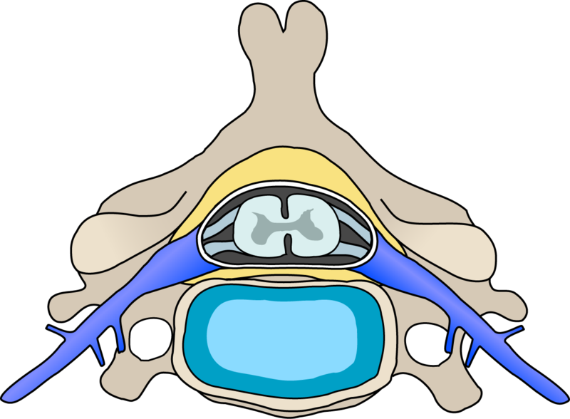
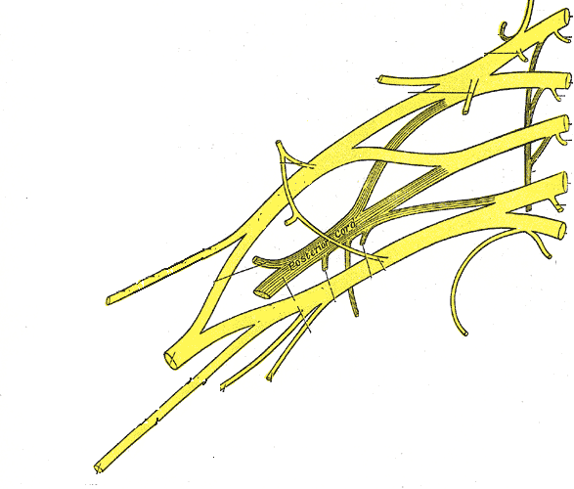
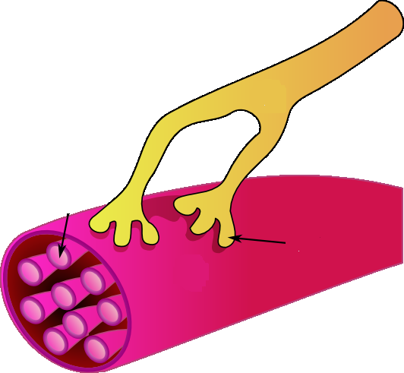
The PNS (Emphasizing Motor Structures)
Brachial
plexus
Anterior horn
cells (LMN)
C8 spinal nerve root
Ulnar nerve
Neuromuscular junction and muscle

Slide 4
Introduction
Peripheral neuropathy is the term for damage to nerves of the peripheral nervous system, which may be caused either by diseases of the nerve or from the side-effects of systemic illness.

Slide 5
Introduction
Peripheral neuropathy affects ~2–8% of adults; the incidence increases with age.

Slide 6
Peripheral nervous system
The peripheral nervous system is made up of three main types of nerves, each with its own specific function:
- Automatic nerves help regulate the automatic functions of the body, such as blood pressure, bladder function and sweat levels.
-

Slide 7
Peripheral nervous system
- Motor nerves control the muscles of the body.
- Sensory nerves pass sensations, such as cold, heat or pain, from the affected area of the body to the brain.

Slide 8
Classification
the type of nerve cell affected
motor
sensory
autonomic

Slide 9
Many peripheral axons are myelinated
Myelin (Schwann cells)

Slide 10
Classification
the process affecting the nerves Demyelinating
Axonal
Neuronal

Slide 11
Symptoms of PNS Disease
Single focal lesions: weakness/numbness/ pain in one limb, often defined to one part of the limb
Multiple or diffuse lesions: weakness/ numbness/pain in more than one limb, usually bilateral and distal

Slide 12
Signs of PNS Disease
Lower motor neuron signs (atrophy, fasciculations)
Hyporeflexia or areflexia
Patch of sensory loss, or stocking-glove sensory loss
Not UMN signs (spasticity, hyperreflexia, upgoing toe) or “brain” signs (impaired consciousness, cognition, or language)

Slide 13
Reflexes… repeated
Hyperreflexia and spasticity occur with upper motor neuron lesions (CNS)
Hyporeflexia, fasciculations, atrophy with lower motor neuron lesions (PNS)

Slide 14
Reflexes… repeated
Hyperreflexia and spasticity occur with upper motor neuron lesions (CNS)
Hyporeflexia, fasciculations, atrophy with lower motor neuron lesions (PNS)

Slide 15
Classification
Peripheral neuropathy may be classified in a varieties of ways-
according to the
1.number of nerves affected
Mononeuropathy
Mononeuritis multiplex
Polyneuropathy

Slide 16
Definitions
Neuropathy simply means a pathological process
affecting a peripheral nerve or nerves.
Mononeuropathy means a process affecting a single nerve.

Slide 17
Definitions
Mononeuritis multiplex (multiple mononeuropathy and/or multifocal neuropathy) affects several or multiple nerves.
Polyneuropathy describes diffuse, symmetrical disease, usually commencing peripherally.

Slide 18
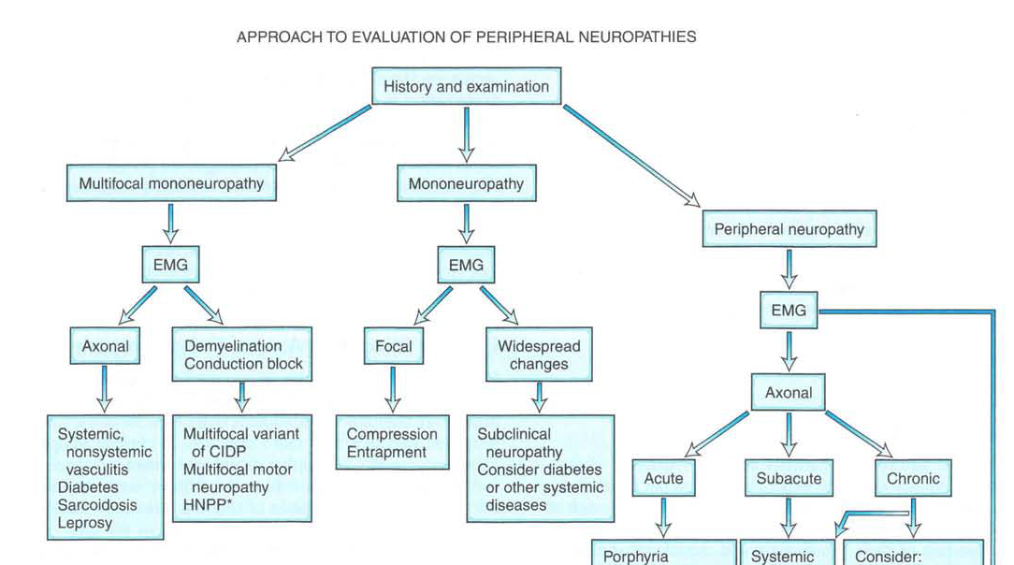

Slide 19
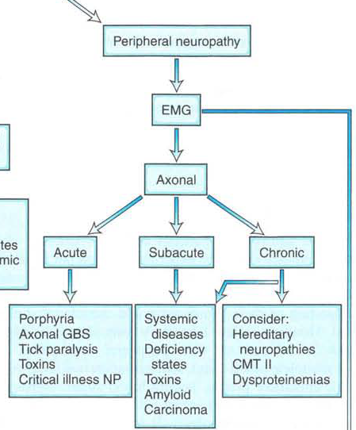
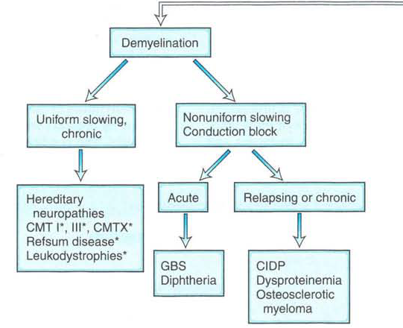

Slide 20
Mononeuropathy
Brachial plexus
C8 spinal nerve root
Ulnar nerve
Neuromuscular junction and muscle

Slide 21
Mononeuropathy
Mononeuropathy is a type of neuropathy that only affects a single nerve.
The most common cause of mononeuropathy is by physical compression of the nerve, known as compression neuropathy.

Slide 22
Mononeuropathy
Weakness, numbness, pain, paresthesias confined to the distribution of
UE: median nerve, radial n., ulnar n.
LE: femoral n., sciatic n., peroneal n.
Most common causes: entrapment, trauma, prolonged limb immobility (e.g., surgery)

Slide 23
Important Mononeuropathies
Median mononeuropathy at the wrist (carpal tunnel syndrome)
Ulnar mononeuropathy at the elbow (cubital tunnel syndrome)
Radial mononeuropathy (“Saturday night palsy”)→ wrist and finger drop
Peroneal mononeuropathy (e.g., from leg crossing)→ one cause of footdrop

Slide 24
Named peripheral nerves have well-defined sensory territories (and muscle targets)
Ulnar n.
Median n.
Peroneal n.

Slide 25
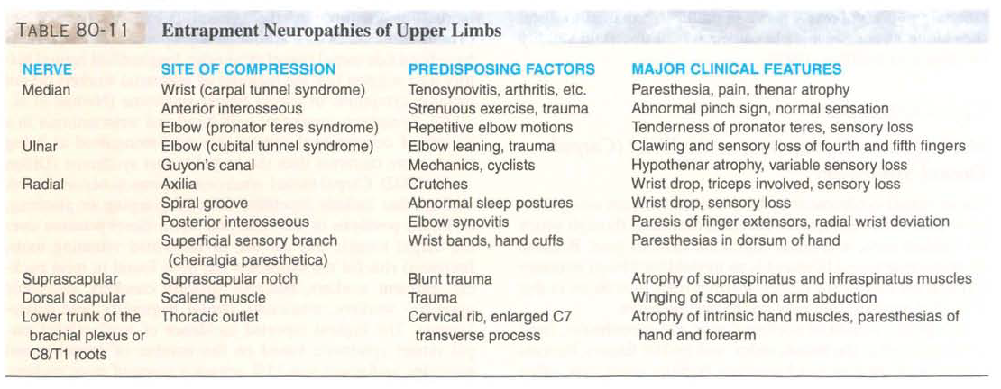

Slide 26
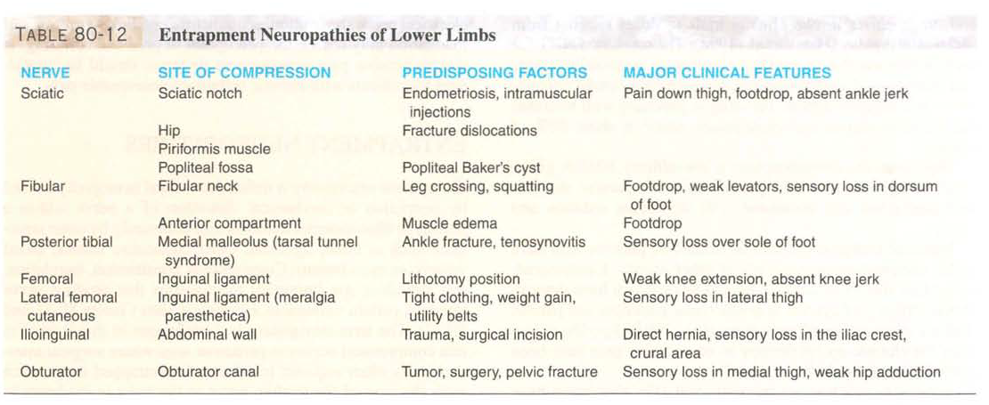

Slide 27
Mononeuritis multiplex
Mononeuritis multiplex is simultaneous or sequential involvement of individual noncontiguous nerve trunks, either partially or completely, evolving over days to years and typically presents with acute or subacute loss of sensory and motor function of individual peripheral nerves.

Slide 28
Mononeuritis multiplex
This occurs in:
■ diabetes mellitus
■ leprosy
■ vasculitis
■ sarcoidosis
hypothyroidism

Slide 29
Mononeuritis multiplex
■ amyloidosis
■ malignancy
■ neurofibromatosis
■ HIV infection
■ Guillain–Barré syndrome – usually polyneuropathy.
Hereditary Neuropathy with Liability to Pressure Palsies
■ idiopathic multifocal motor neuropathy.

Slide 30
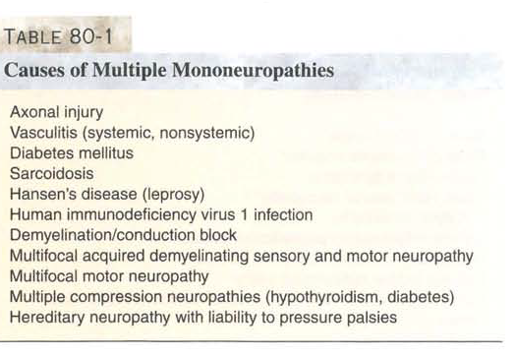

Slide 31
Peripheral Polyneuropathy

Slide 33
Polyneuropathy
Polyneuropathy- The term "peripheral neuropathy" is sometimes used loosely to refer to polyneuropathy. Most cases of peripheral neuropathy affect the sensory and motor nerves..

Slide 34
Polyneuropathy
Longest fibres are affected first so symptoms usually first develop in the extremities of your body, such as your feet, legs and hands and arms. This type of neuropathy is called generalised sensorimotor polyneuropathy

Slide 35
Polyneuropathy
The course may be
- acute, chronic, static, progressive, relapsing or towards recovery.
Polyneuropathies are motor, sensory, sensorimotor and autonomic.

Slide 36
Polyneuropathy
They are classified broadly into demyelinating and axonal types, depending upon which principal pathological process predominates.

Slide 37
Polyneuropathy
Many systemic diseases cause neuropathies. Widespread loss of tendon reflexes is typical, with distal weakness and distal sensory loss.

Slide 38
Clinical features
Sensorimotor polyneuropathy
Symptoms of generalised sensorimotor polyneuropathy can include:
prickling and tingling sensation in the affected body part (pins and needles)
numbness and a reduced ability to feel pain or changes in temperature, particularly in your feet

Slide 39
Clinical features
a burning pain, usually in the feet and legs, followed by the hands and arms as the neuropathy progresses
sharp stabbing pain, which is often worse at night (again, the feet and legs are affected first, followed by the hands and arms)

Slide 40
Clinical features
muscle weakness
loss of co-ordination
muscle paralysis
increased risk of developing problems that affect the feet, such as skin infections and foot ulcers

Slide 41
Clinical features
Signs-It depends on the types, severity and nerve cells involved.
Motor signs- lower motor neuron lesion-wasting ,fasciculation and loss of reflexs
Sensory signs-diminished or loss of sensation of all modalities of sensation

Slide 42
“Peripheral Neuropathy”
Distal symmetric polyneuropathy
Affects longest sensory/ motor/ autonomic nerves
Nerves are “dying back”
Length dependent (“stocking glove”)
Symmetric loss of pin/ temp / vibration/ proprioception; distal reflex loss
Usually chronic. Many possible causes!

Slide 43
Peripheral polyneuropathy symptoms
Initially, feet numb with paresthesia/ pain
Symptoms ascend: → legs→ fingertips
Distal weakness (feet, or fingers/grip), atrophy,
Severe sensory loss can cause “steppage gait”, “sensory ataxia”, imbalance, falls
Feet prone to injuries, ulcers, deformation (e.g., “Charcot foot”)
Autonomic: orthostasis, bladder and erectile dysfunction

Slide 44
TYPES AND CAUSES OF PERIPHERAL NEUROPATHY
Acute | Chronic
Guillain-Barré Alcohol Guillain-Barré variants Toxins Porphyria Paraneoplastic | Hereditary CIDP Lymphoma Osteoclastic myeloma IgM paraproteinaemia Arsenic toxicity Amiodarone toxicity Diphtheria/Alcohol Metabolic/endocrine diseases (including diabetes) Drugs and toxins Vitamin deficiency Hereditary IgG paraproteinaemia Paraneoplastic Primary amyloidosis

Slide 45
Common causes
A - Alcohol,Arsenic toxicity
B - Vit.deficiency-B1,6,12 def.
C - CRF,Carcenomatous –lymphoma,myeioma, connective tissue disease-RA
D - Diabetes, Drugs-INH, Metronidazole
H-Hereditary
I-Infection-leprosy, GBS

Slide 47
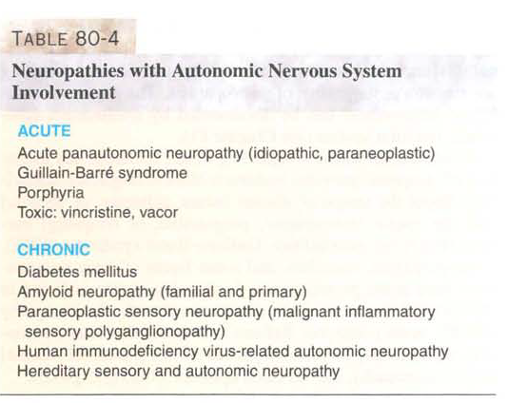

Slide 48
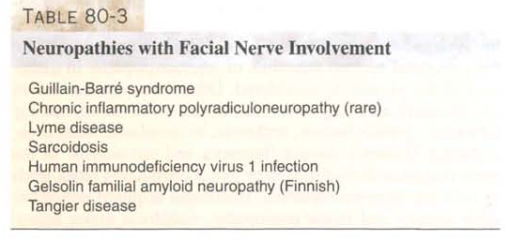

Slide 49
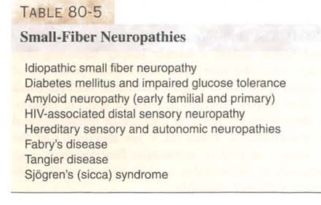

Slide 50
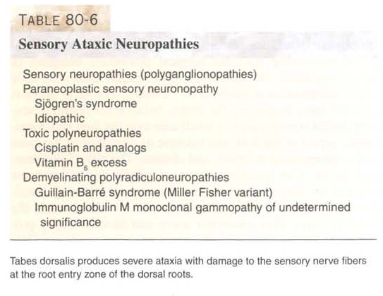

Slide 51
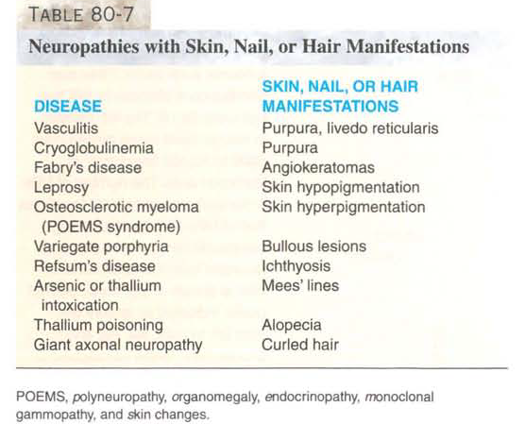

Slide 52
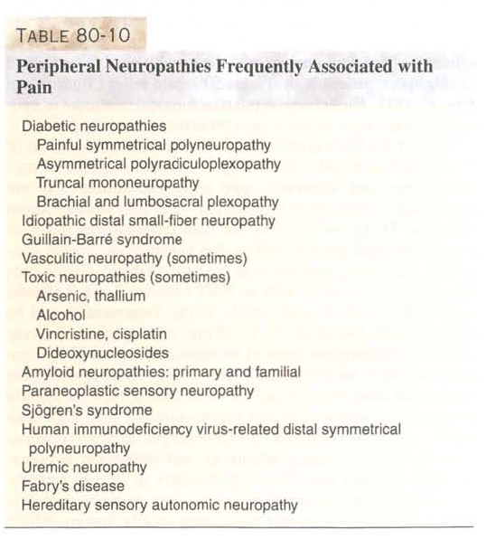

Slide 53
Diagnosis
Diagnosis- is largely clinical, supported by electrical studies.
A number of tests can be used to confirm peripheral neuropathy . These include:
nerve conduction test and electromyography (EMG)
nerve biopsy

Slide 54
Diagnosis
Other investigations to detect underlying causes-
Blood tests
Blood sugar,HbA1c
Urea and electrolytes,
Thyroid function tests
Vitamin B12
Venereal Diseases Reasearch Laboratory (VDRL) test
ANA, anti-dsDNA
Chest X-ray

Slide 55
Treatment
Treatment for peripheral neuropathy will first address the condition’s underlying causes.
For example, in cases of diabetic polyneuropathy, a number of lifestyle changes and treatment are taken to prevent further nerve damage. This may be:
giving up smoking

Slide 56
Treatment
cutting down on your alcohol consumption, or ideally not drinking alcohol at all
maintaining a healthy weight, if you are overweight or obese
taking plenty of exercise
tight glycaemic control

Slide 57
Neuropathic pain
As well as addressing the underlying causes of peripheral neuropathy, give additional medication to treat the symptoms of nerve pain. The medical term for nerve pain is neuropathic pain.

Slide 58
Neuropathic pain
Unlike most other types of pain, neuropathic pain does not usually respond well to treatment with widely used painkillers, such as paracetamol and ibuprofen. Therefore, alternative medications are usually required.

Slide 59
Neuropathic pain
Initial treatments
Medications called amitriptyline and pregabalin are the initial treatments for people with neuropathic pain.

Slide 60
Guillain barre syndrome

Slide 61
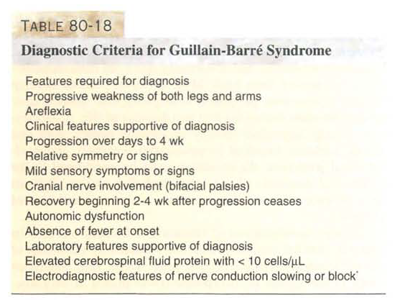
Guillain barre syndrome

Slide 62
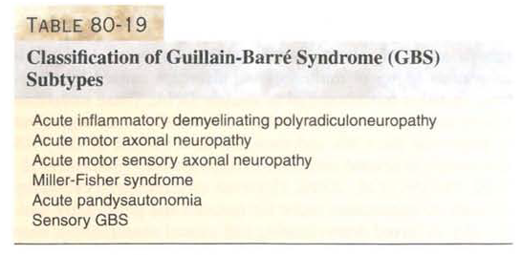
GBS

Slide 63
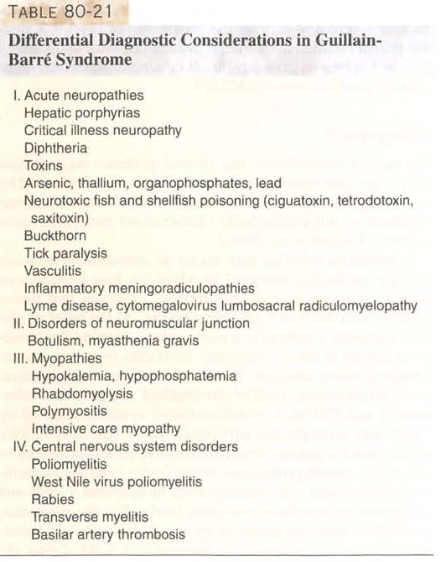
GBS

Slide 64
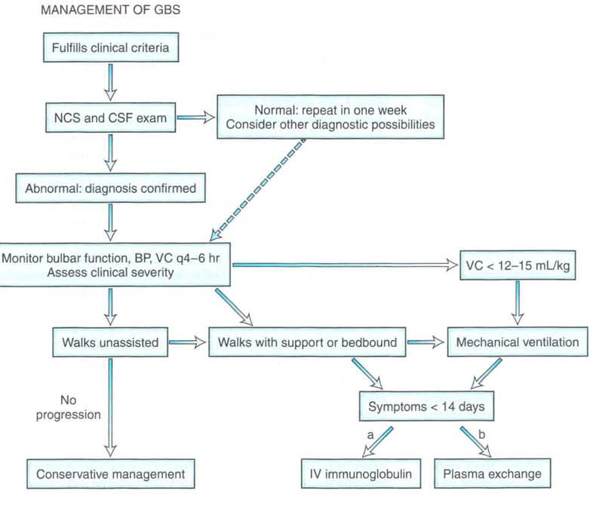

Slide 65
Chronic Immune-Mediated Demyelinating Polyneuropathy

Slide 66
Immune-Mediated Polyneuropathy: Introduction
Our understanding of the acquired immune-mediated polyneuropathies has grown dramatically over the past 20 years
In the past, divided into acute (Guillain-Barre Syndrome) and chronic (CIDP)
Not known to comprise a variable, numerous, and heterogeneous set of disorders

Slide 67
CIMDPs: Introduction
Prior to 1980, chronic inflammatory demyelinating polyradiculoneuropathy (CIDP) and the neuropathy associated with multiple myeloma were the only 2 identified disorders of this category.
Today, there are more than 10 different disorders that fall under this category

Slide 68
The Chronic Immune-Mediated Demyelinating Polyneuropathies
CIDP and Variants Other CIMDPs
“Classic” CIDP Disorders with distinct
Prototype of this disorder characteristics, not likely
to represent same disease as CIDP
“Atypical” CIDP
Disorders with different
Phenotype than classic CIDP,
but unlikely to be distinct diseases

Slide 69
Overview: CIMDPs
Classic CIDP
Atypical variants of CIDP
CIMPDs distinct from CIDP

Slide 70
Overview: More Detail
Classic CIDP
Presentation and Symptoms
Evaluation and diagnosis
Treatment and prognosis
Atypical variants of CIDP
Multifocal sensorimotor
Distal symmetrical sensorimotor
Pure sensory

Slide 71
Overview: More Detail
CIMDPs distinct from CIDP
-Multifocal Motor Neuropathy
-Anti MAG Neuropathy
-PN associated with osteosclerotic myeloma
PN associated with IGM MGUS (not anti-MAG)
Chronic ataxic Neuropathy with opthalmoplegia (CANOMAD)

Slide 72
Chronic Inflammatory Demyelinating Polyneuropathy
Chronic Inflammatory Demyelinating Polyradiculoneuropathy was first described as an entity in 1975 (Dyck et al. 1975), although numerous case reports exists in the earlier literature describing patients with relapsing polyneuropathy responsive to steroids
(Branagen et al., 2008)

Slide 73
CIDP
CIDP is a chronic sensorimotor polyneuropathy characterized by:
Greater than 2 months of progressive weakness, sensory loss, and decreased or absent reflexes
Nature of progression may be
relapsing/remitting, progressive relapsing, or steadily progressive

Slide 74
CIDP-Epidemiology
Estimates of prevalence vary (1-7.7 per 100,000)
Incidence increases with age
Men more likely to be affected than women
Prevalence in Men ages 70-79 is 1 in 10,000
Likely to be seriously underestimated

Slide 75
CIDP-Pathopsysiology
Autoimmune mechanism
Inflammation in pathological specimens
Response to immunomodulatory treatment
Antibody mediated (antibody and complement present in affected nerve)
Also role of activated T-cells (disruption of BBB)
Macrophages are main endoneural inflammatory cell seen in CIDP (ingestion of myelin)

Slide 76
CIDP: Clinical Presentation
Greater 2 month history of progressive sensory and motor symptoms
Some degree of sensory and motor dysfunction on examination in peripheral nerve pattern
Decreased or absent reflexes

Slide 77
CIDP- Classic Phenotype
Weakness is more prominent than sensory loss
Weakness involves both proximal and distal muscles
Weakness is usually symmetrical, but may begin asymmetricaly

Slide 78
CIDP: Diagnostic Studies
No laboratory blood test helpful
CSF analysis
elevated CSF protein in 80% of patients
Electrophysiological
Nerve conduction studies extremely useful
Pathology
Nerve biopsy sometimes helpful

Slide 79
CIDP: Electrophysiological Tests
Nerve Conduction studies (NCS)
-Identify multifocal demyelination
-Distinguish between axonal and demyelinating
pathophysiology
-Exclude inherited neuropathies
AAN criteria for edx dx of CIDP for research studies: 3 demyelinating findings in 2 nerves, specific but not sensitive (less than 50%)

Slide 80
CIDP: Diagnosis
Diagnosis may be easy or may be difficult, no sensitive and specific diagnostic test, clinically heterogeneous.
Various diagnostic criteria have been proposed including clinical findings, electrodiagnostic findings, elevated CSF protein, positive pathology

Slide 81
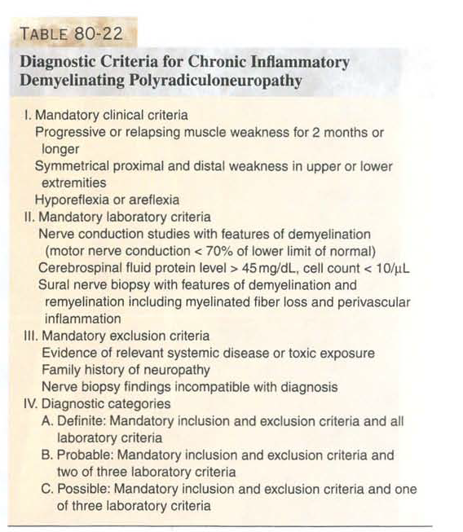
CIDP

Slide 82
CIDP: Diagnostic Challenges
(Barohn et al, 1989)
A series of patients with clinical findings of proximal and distal weakness consistent with CIDP were treated.
95% had significant improvement with treatment
30% had “classic” diagnostic triad of slow nerve conduction velocities on NCS, elevated CSF protein, and demyelination of nerve biopsy

Slide 83
CIDP: Treatment Options
Immunomodulatory Therapy
-Prednisone
-Intravenous Immunoglobulin (IVIg)
-Plasmapheresis
All have been shown to be effective in controlled clinical trials.
In refractory patients, other agents are used with variable results (cyclophosphamide, mycophenolate, azathioprine, interferons, cyclosporine)

Slide 84
Treatment duration
Treatment is continued for as long as patient continues to improve
Once stable, trial of decreasing/discontinuing therapy is pursued
Therapy is then adjusted per patient’s needs
Majority of patients will need ongoing treatment:
less than 1/3 will remain in remission without ongoing therapy

Slide 85
CIDP: Treatment Summary
Most improve to some extent, some dramatically
Some are refractory (unclear why)
IVIg safe for long-term ongoing treatment in most patients

Slide 86
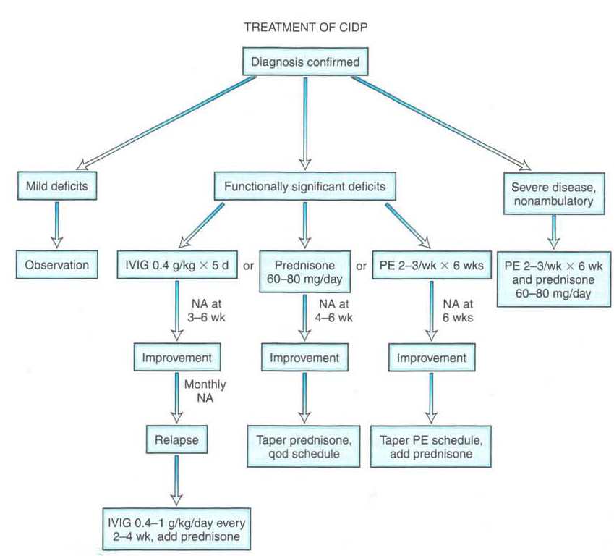

Slide 87
Atypical CIDP
Chronic demyelinating polyneuropathy syndromes with presentations, phenotypically different from classic CIDP
Do not present with typical proximal and distal weakness, large fiber sensory loss, areflexia
Thought to be variants of CIDP, rather than different diseases
That is, alternate, less common phenotypes that share underlying pathophysiological mechanism

Slide 88
Atypical CIDP: Multifocal Sensorimotor
Phenotype: Mononeuritis Multiplex
Multifocal, asymmetrical, involving nerves in any/all limbs, approximately equal predilection for sensory and motor fibers
Focal sites of demyelination, conduction block
--Lewis-Sumner Syndrome, Multifocal Acquired Demyelinating Sensory and Motor neuropathy (MADSAM)

Slide 89
Atypical CIDP: Distal Symmetrical
Phenotype: Symmetrical, distal gradient, sensorimotor polyneuropathy
Sx similar to typical axonal distal gradient neuropathies, also anti-MAG
DADS-I (Distal Acquired Demyelinating Symmetrical-idiopathic)

Slide 90
Atypical CIDP: Sensory CIDP
Phenotype: Pure sensory symptoms and clinical deficits, including development of severe sensory type gait ataxia
May find evidence of demyelination of motor nerves on NCS despite lack of clinical weakness
Sometimes progress to develop clinical weakness

Slide 91
Atypical CIDP Variants
Compared with classic CIDP:
--Same degree of CSF protein elevation
--Same sural nerve biopsy findings
--Evidence of demyelination on NCS (though
may not see on routing NCS in sensory CIDP)
*Respond to same treatments, to same degree and extent a classic CIDP

Slide 92
CIMDPs distinct from CIDP
Acquired polyneuropathy syndromes that are LIKE CIDP in that they are chronic, immune- mediated, primarily demyelinating.
But are unlike CIDP in that they manifest unique clinical and diagnostic characteristic, respond to the treatment differently.
----Thought to result from different and distinct pathophysiological disease processes

Slide 93
CIMDP Syndromes Distinct from CIDP
Multifocal Motor Neuropathy (with conduction block) (MMN)
Anti-MAG neuropathy
Polyneuropathy associated with osteosclerotic multiple myeloma (with or without rest of POEMS syndrome)
Polyneuropathy associated with monoclonal gammopathy (MGUS) (not anti-MAG)
Chronic ataxic neuropathy and ophthalmoplegia (CANOMAD)

Slide 94
Autoantibody Associations
Some of these syndromes are associated with specific autoantibodies :
MMN (anti-ganglioside abs GM1, GD1a)
Anti-MAG neuropathy (anti-MAG abs)
CANOMAD (anti-disialosyl abs)

Slide 95
CIDMP Syndromes Distinct From CIDP
With auto-antibody Without auto-antibody
Associations Associations
MMN Neuropathy associated with IgM monoclonal gammopathy (without anti-MAG
Anti-MAG neuropathy antibodies or anti-disialosyl abs)
CANOMAD
-Can present similar by to classic CIDP or any atypical CIDP variants
-Does not respond well to IVIG (and often is refractory to all treatment)

Slide 96
Demyelinating Polyneuropathy Associated with osteosclerotic Multiple Myeloma
Osteosclerotic myeloma =3% of MM usually does NOT include bone pain as sx 50% will have Polyneuropathy
Polyneuropathy often presenting symptom
Will have monoclonal IgG/IgA, but level may be low, and often missed on SPEP (need IFE)
May be part of POEMS syndrome (polyneuropathy, organomegaly, endocrinopathy, M-protein, skin changes)

Slide 97
Demyelinating Polyneuropathy Associated with osteosclerotic Multiple Myeloma
Should consider diagnosis in patients with monoclonal gammopathy and demyelinating polyneuropathy.
Skeletal survey (bone scan not sensitive for osteosclerotic lesions)
Effective treatment of cancer often results in improvement of neuropathy, little else is effective

Slide 98
CIMDP Syndromes distinct from CIDP with Autoantibody Associations
Multifocal Motor Neuropathy
Anti-MAG Neuropathy (More on these symptoms in next lecture)
CANOMAD

Slide 99
CIMDPs
Classical and Atypical CIDP Non-CIDP Syndromes
CSF protein: CSF protein:
Mild, moderate minimal to no elevation
elevation
Prednisone/steroid: Prednisone/steroid:
good response poor or no response

Slide 100
CIDP: as superimposed syndrome
Diabetes Mellitus
CMT
May predispose patients to super imposed CIDP which is treatable condition

Slide 101
Chronic Immune-Mediated Demyelinating Polyneuropathies
Most of these neuropathies are treatable. Respond very well to safe and well-tolerated treatment modalities.
If you don’t look for it, you won’t find it.
People with diabetes can also develop acquired treatable neuropathy.
Be aware of the variants: Not all distal symmetrical neuropathies are axonal

Slide 102
MMN

Slide 103
با تشکر

